Slide 1
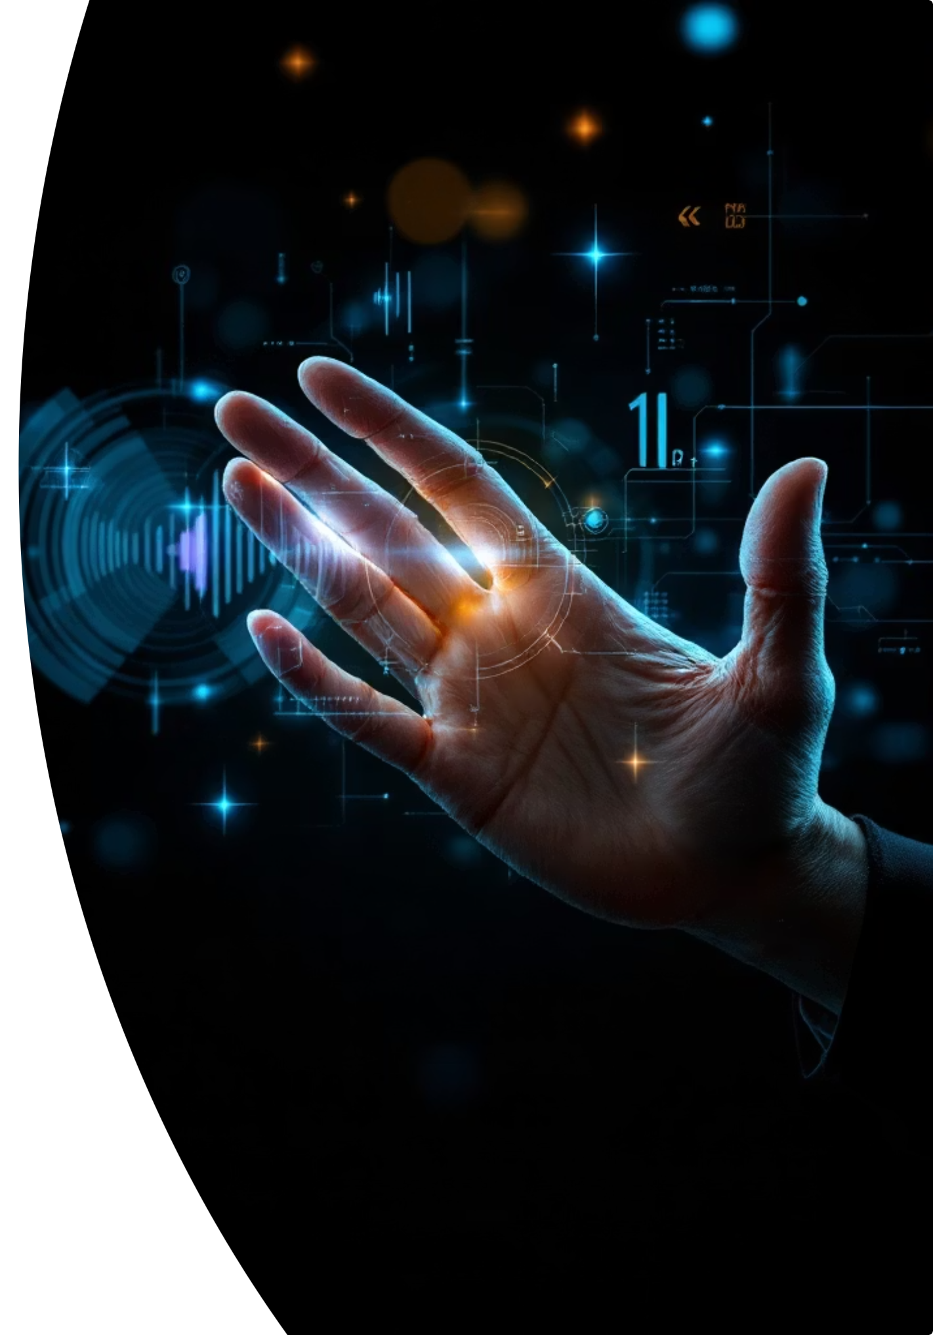
Gesture-Based Volume Control Using Hand Movements
Experience seamless, hands-free volume control! This innovative computer vision project lets you adjust your system's audio with simple hand gestures, all captured through your webcam.
Presented by -Saswat Sharma
Mentor- Ram Prasad
Batch - 2

Slide 2




Introduction
This project introduces a real-time gesture recognition system designed for hands-free volume control. Utilizing a standard webcam, users can intuitively adjust audio levels through simple hand movements, enhancing accessibility and user experience in various computing environments. This innovative approach allows for seamless interaction, particularly beneficial in situations where traditional input methods are inconvenient or impossible.
Tools & Technologies Utilized
Python
OpenCV
The core programming language chosen for its extensive libraries and ease of development in AI and computer vision.
A powerful open-source library used for real-time image and video processing, crucial for capturing and manipulating webcam input.
MediaPipe
PyCaw
Google's framework for building multimodal applied machine learning pipelines, specifically used here for accurate hand detection and landmark tracking.
A Python library enabling direct interaction with the Windows Core Audio API for precise control over system volume levels.

Slide 3
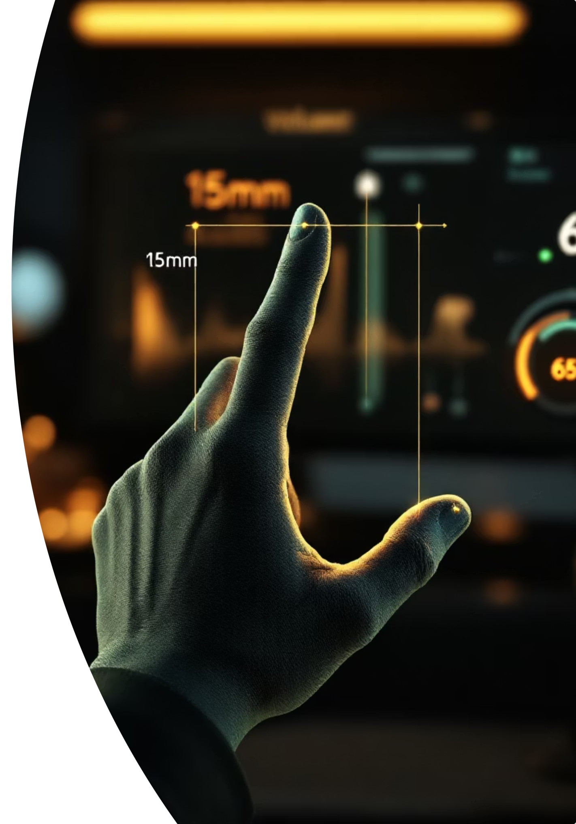
Key Outcomes
This project aims to deliver an intuitive and highly accessible volume control solution with the following core outcomes:
1
2
Precise Hand Tracking
Intuitive Gesture Control
Real-time processing of webcam input to accurately detect and track hand movements and individual finger landmarks using MediaPipe Hands.
Classification of natural hand gestures, such as the distance between the thumb and index finger, to translate into precise volume adjustments.
3
4
Rich Visual Feedback
Universal Accessibility
A user-friendly interface providing real-time visual cues, including detected hand landmarks and the current volume level, for immediate understanding.
The system is designed to function with any standard webcam, requiring no additional specialized hardware, making it widely accessible.

Slide 4




Modules to be Implemented
Our system is structured into four core modules, each building upon the functionality of the last to deliver a seamless gesture-based volume control experience.
Webcam Input & Hand Detection
Gesture Recognition & Distance Measurement
This foundational module leverages OpenCV to capture live video from the webcam. It then employs MediaPipe Hands to precisely detect hands and extract 21 key landmarks in real-time, providing the essential data for subsequent analysis.
Building on the detected landmarks, this module analyzes the positions of the thumb and index fingertips. It calculates the distance between these points and classifies specific gestures (e.g., "Pinch," "Open Hand") based on predefined thresholds.
Output: Live video feed with overlaid hand landmarks.
Output: Real-time display of calculated distance and gesture classification.
Volume Mapping & Control
User Interface & Feedback
This module translates the measured gesture distance into a system volume level (0-100%). Utilizing PyCAW, it dynamically adjusts the system's audio. A built-in smoothing function prevents abrupt volume changes, ensuring a fluid user experience.
The final module presents all system outputs on an interactive Streamlit dashboard. It overlays the detected gesture name, measured distance, and current volume directly onto the live camera feed, complemented by visual indicators for clear user feedback.
Output: Smooth, real-time volume adjustment synchronized with hand gestures.
Output: A comprehensive interactive UI showcasing live gesture control and system responses.

Slide 5
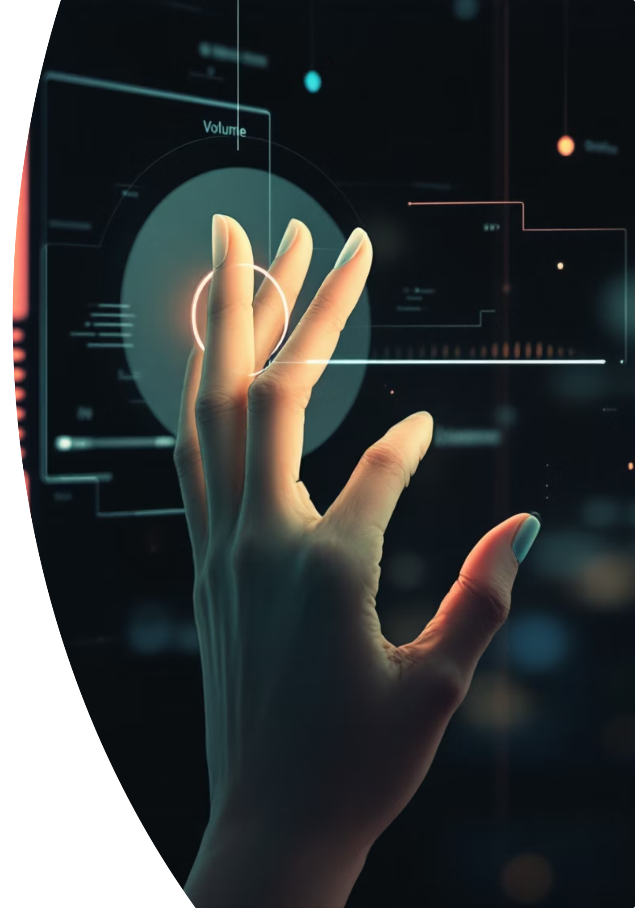
Milestone 1 : Core Application Foundation
This pivotal initial milestone establishes the fundamental architecture of our innovative gesture-based volume control system. This phase is dedicated to perfecting robust hand detection, ensuring precise gesture interpretation, and achieving seamless integration with underlying system audio controls, all effortlessly accessible via a standard webcam.
Advanced Real-time Hand & Gesture Recognition
Responsive & Refined Volume Modulation
Leveraging webcam input and the sophisticated MediaPipe framework, our system precisely tracks 21 distinct hand landmarks, enabling accurate classification of nuanced gestures, such as the crucial thumb-index distance for control.
Translating detected gestures into granular system volume adjustments (ranging from 0-100%), our solution integrates advanced smoothing algorithms and noise reduction to deliver an exceptionally fluid and responsive user experience.
Intuitive Feedback & Universal Accessibility
OpenCV – Computer Vision Foundation
OpenCV (Open Source Computer Vision Library) is used to capture and process live webcam video frames in real time. It provides essential tools for image processing, object tracking, and pixel-level analysis, enabling smooth and accurate hand detection.
The system provides immediate, clear visual feedback on detected hand landmarks and current volume levels directly within the user interface, ensuring a transparent and accessible experience. Full functionality is achieved with the sole requirement of a standard webcam.

Slide 6
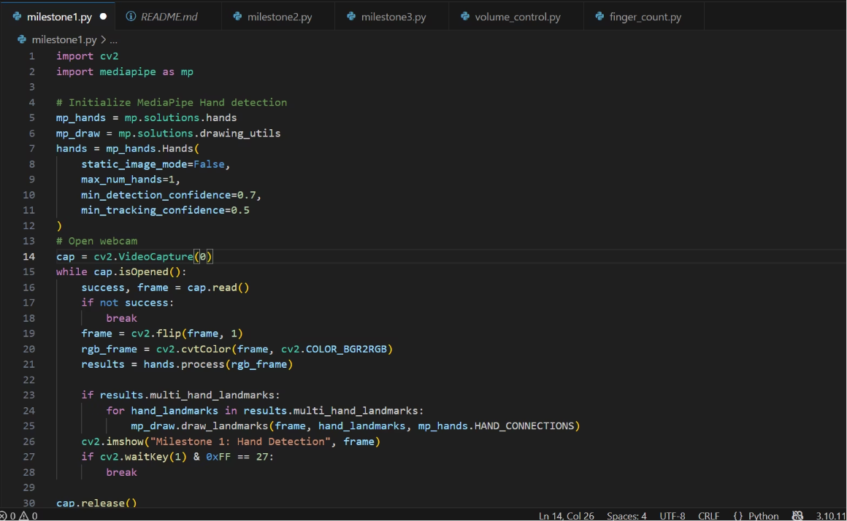
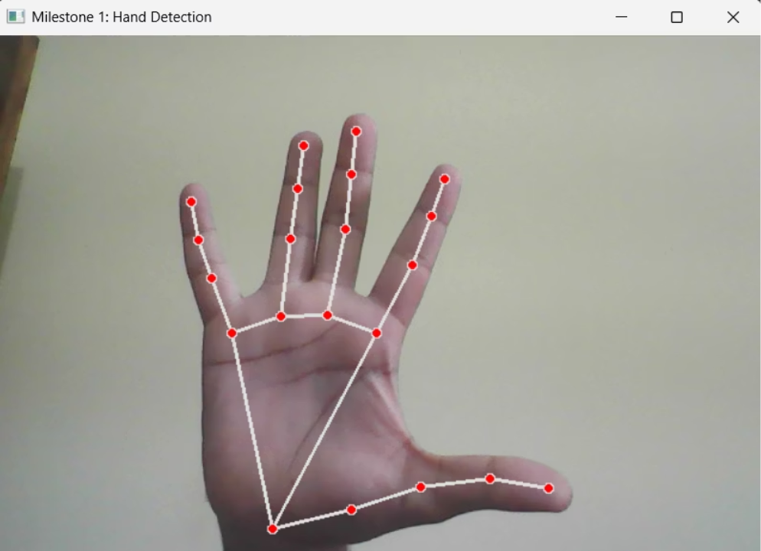
Milestone 1 : Code and Live Output
Here, we present the tangible results of Milestone 1, showcasing the core application foundation through its underlying code and a live demonstration of the gesture-based volume control system in action. These visuals confirm the successful implementation of real-time hand detection and responsive volume modulation.
Code Implementation: Gesture Recognition Logic
Live Output: Real-time Gesture Control
This screenshot displays a snippet of the Python code of our system. It highlights the integration of MediaPipe for real-time hand landmark detection and the logic for calculating the distance between the thumb and index finger .It also integrates the opencv module that uses the webcam.
This image captures the live output of our system in operation. It visibly demonstrates the precise tracking of hand landmarks, the interpretation of the thumb-index gesture, and the immediate, smooth adjustment of the on-screen volume indicator.

Slide 7
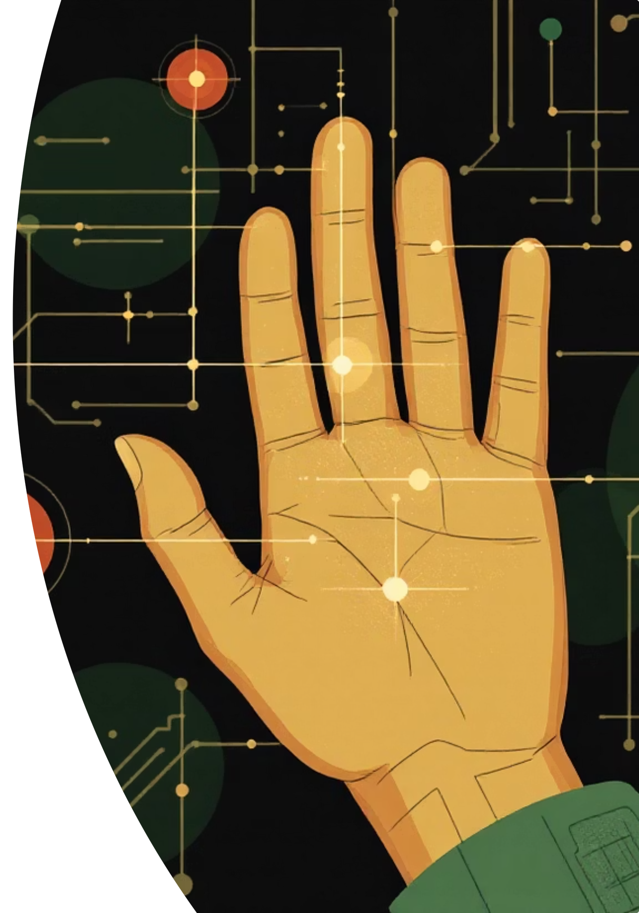
Milestone 2 : Gesture Recognition & Distance Measurement
Building on the foundational hand detection, this module processes the intricate data from 21 hand landmarks to translate physical movements into actionable commands. It's the brain of our gesture control system, interpreting nuances in hand posture.
Landmark Data Processing
Thumb-Index Distance Calculation
Receives real-time coordinates for 21 hand landmarks from MediaPipe, forming a detailed 3D map of the hand's current position and shape.
Precisely measures the Euclidean distance between the tips of the thumb and index finger, a key indicator for volume control. This is done dynamically for every frame.
Dynamic Gesture Classification
Real-time Output
Compares the calculated distances against a set of predefined thresholds to classify gestures , ensuring responsiveness and accuracy.
Generates a continuous stream of classified gestures and corresponding distance values, which then feed into the volume mapping module for immediate audio adjustment.

Slide 8
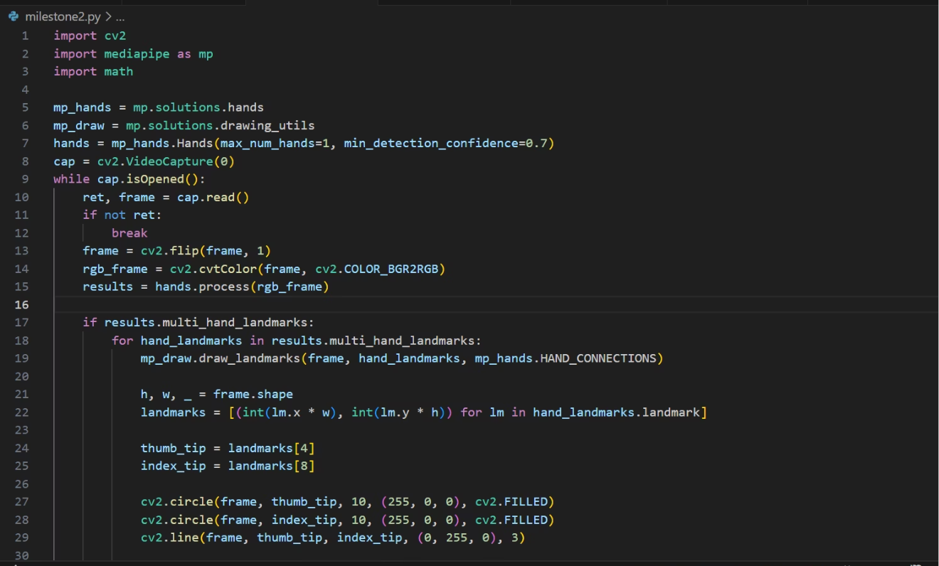
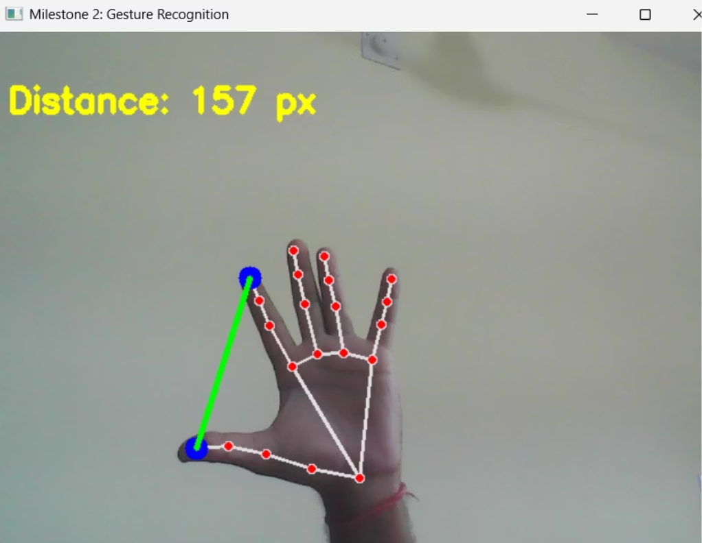
Milestone 2 : Code and Live Output
Code Implementation: Distance Calculation Logic
Live Output: Gesture Classification in Action
This Python code snippet illustrates the core logic for calculating the Euclidean distance between the thumb and index finger landmarks, crucial for interpreting pinch gestures. It integrates MediaPipe's hand tracking capabilities to precisely measure these dynamic distances in real-time.
This screenshot demonstrates the system's real-time output, visualizing the 21 hand landmarks detected by MediaPipe. It shows the dynamic measurement of the thumb-index finger distance and the classification of gestures as they occur, providing immediate visual feedback for interaction.

Slide 9

Milestone 3: Volume Mapping & Control Module
Objective:
Convert thumb–index finger distance into system volume levels (0%–100%). Enable smooth, intuitive control without touching the keyboard or mouse.
Implementation:
This involves detecting hand gestures using MediaPipe or equivalent technology, mapping the distance to a volume percentage using linear interpolation, and then adjusting the system volume in real-time using tools like PyAutoGUI or Pycaw. It's crucial to ensure gradual changes for smooth transitions, avoiding any sudden jumps in volume.
Outcome:
The result is gesture-based volume control, offering a natural user interaction experience. This system provides real-time, precise, and responsive adjustment of system volume.

Slide 10
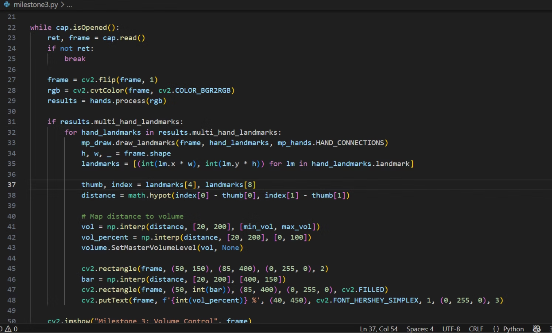
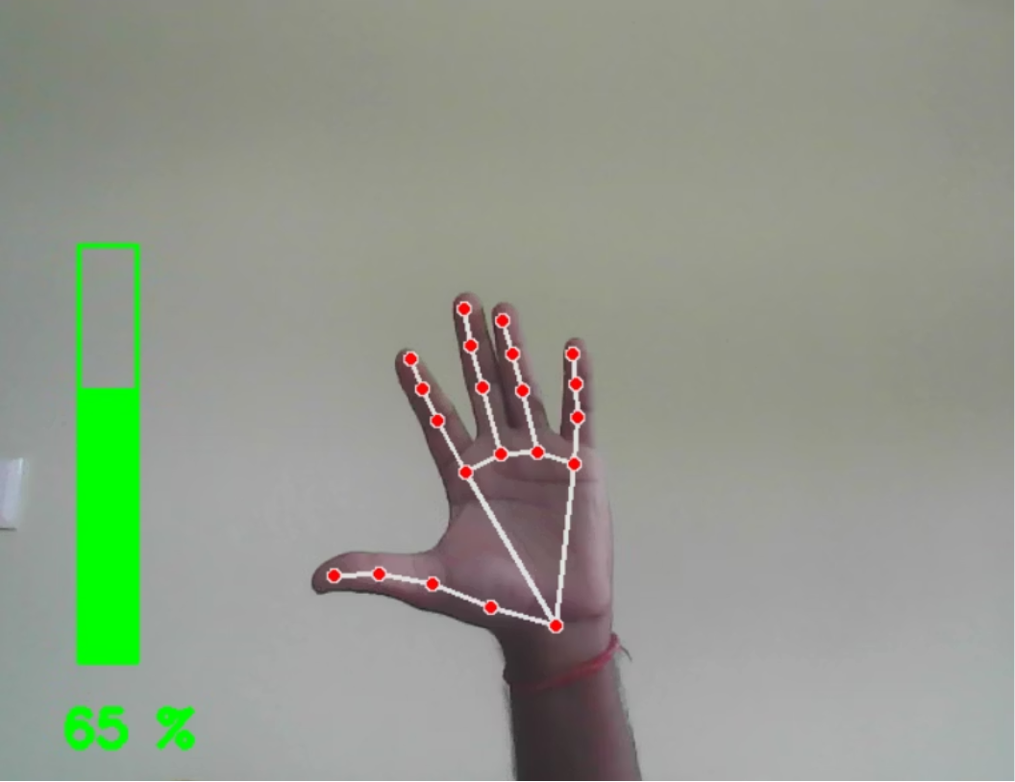
Milestone 3: Code and Live Output
Code Implementation: Gesture to Volume Logic
Live Output: Intuitive Volume Control
MediaPipe detects real-time hand landmarks. The thumb-index finger distance is then mapped to a 0-100% volume percentage. Linear interpolation ensures smooth and gradual volume changes, while PyAutoGUI/Pycaw adjusts the system volume in real-time.
Real-time tracking visualizes hand gestures and landmark points. Visual feedback shows corresponding volume levels, achieving smooth, responsive, and precise system volume adjustment. This offers a natural, keyboard/mouse-free user interaction experience.

Slide 11
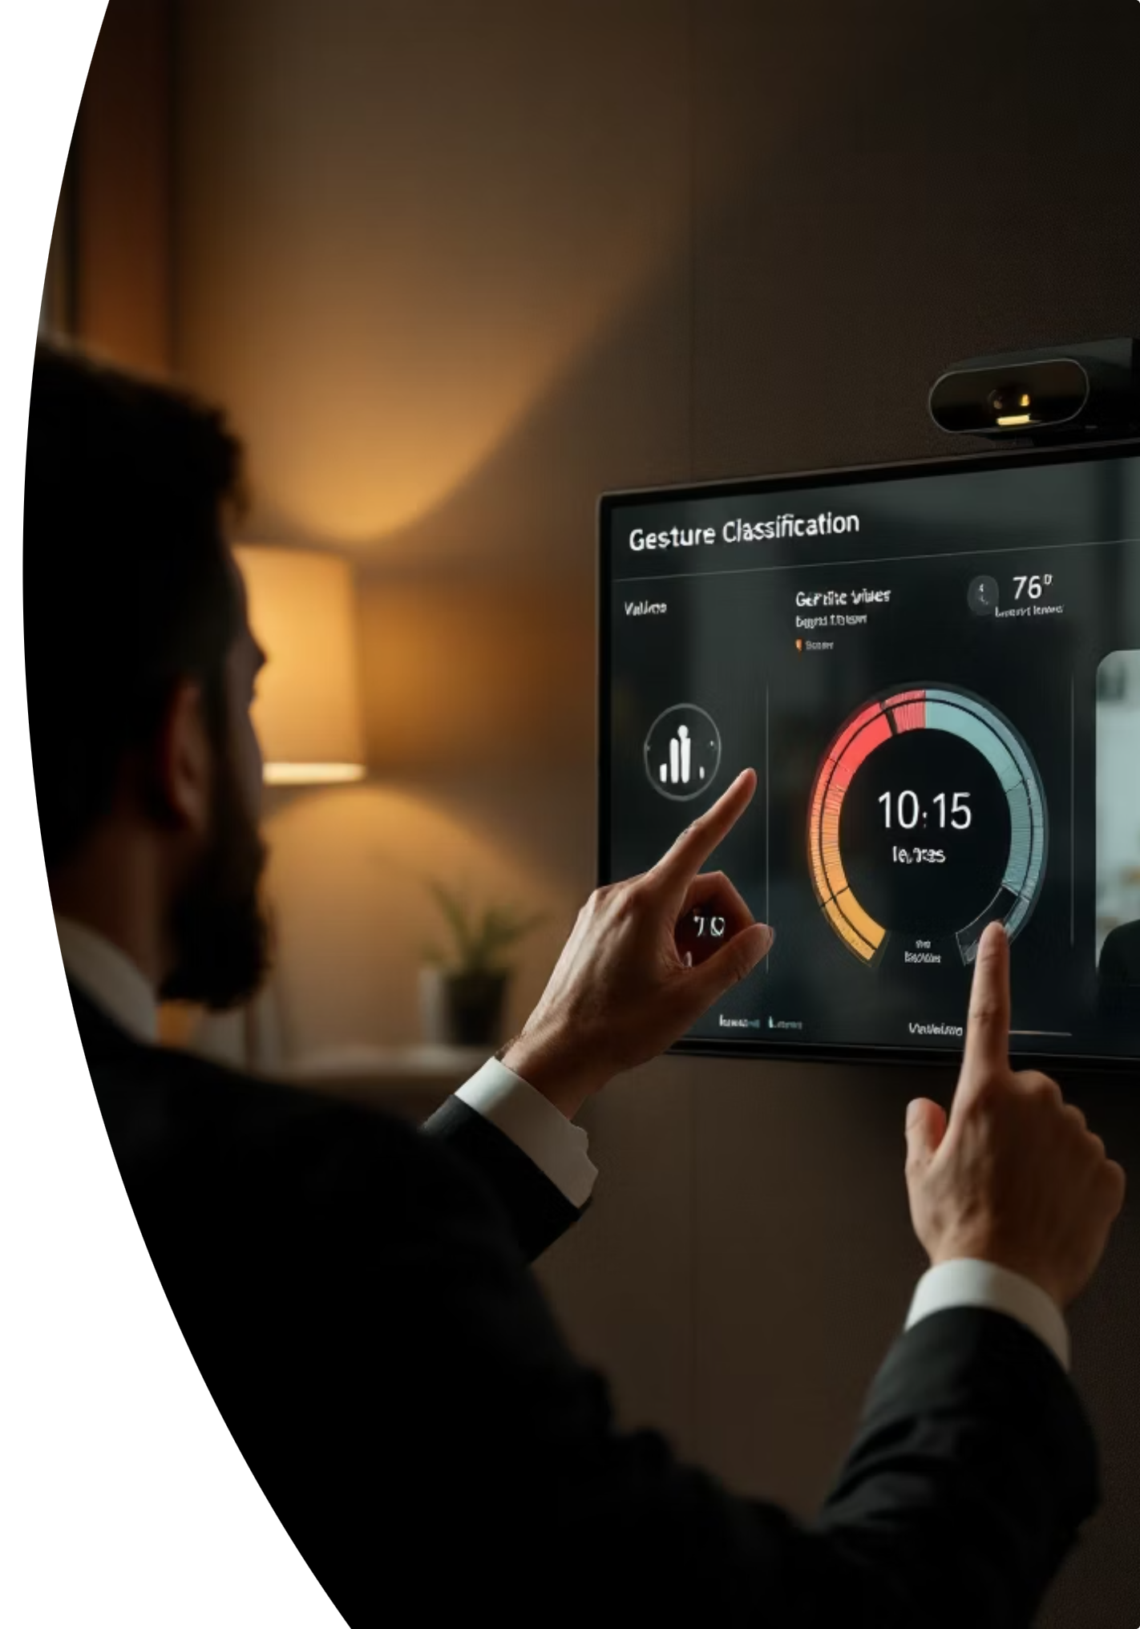
Milestone 4: User Interface & Feedback (Streamlit)
Provide a real-time visual interface for gestures and volume control, enhancing user interaction and system feedback.
Objective
Provide a real-time visual interface for gestures and volume control, enhancing user interaction and system feedback.
Implementation (Using Streamlit)
Gesture Classification: Display the current gesture type detected (e.g., Pinch, Medium, Open).
Volume Bar: A dynamic slider or progress bar showing the current volume level from 0–100%.
Gesture Feedback: Provide visual cues indicating the accuracy or quality of the detected gesture.
Live Video Feed: Overlay all UI elements directly onto the camera stream for intuitive, integrated control.
Outcome
A real-time, interactive, and user-friendly UI that significantly enhances usability and system feedback. This module is designed for easy integration with existing gesture detection and volume mapping modules.

Slide 12
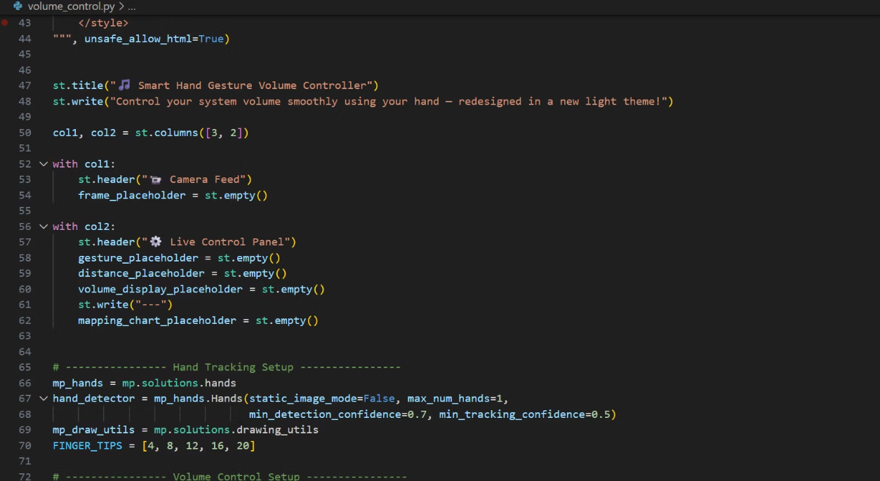
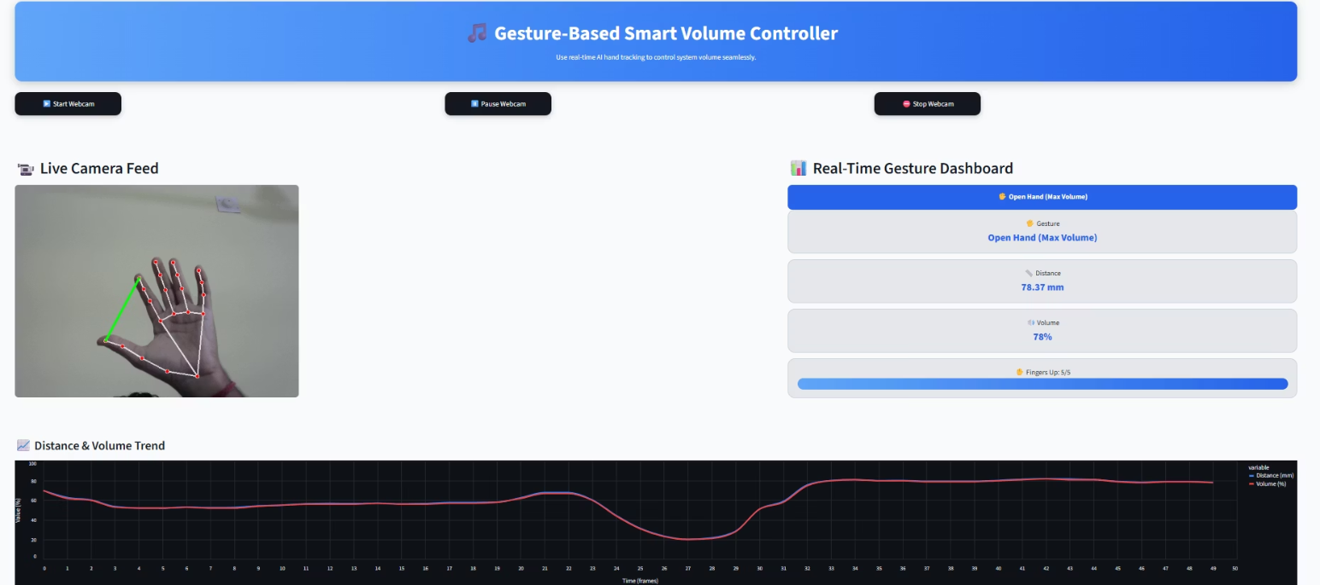
Milestone 4: Code and Live Output
Code : Streamlit UI Components
Live Output: Streamlit Interface
This screenshot displays the Streamlit code implementation for the user interface module. It shows the integration of gesture classification display, volume control elements, and real-time feedback components that create an intuitive and responsive user experience.
This image captures the live Streamlit interface in operation, demonstrating the real-time display of gesture classification, dynamic volume controls, and visual feedback elements overlaid on the camera stream for seamless user interaction.

Slide 13
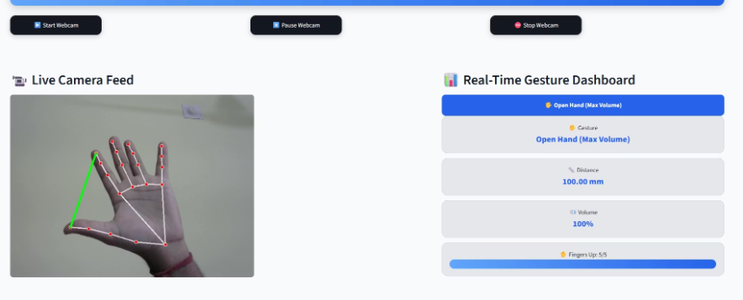
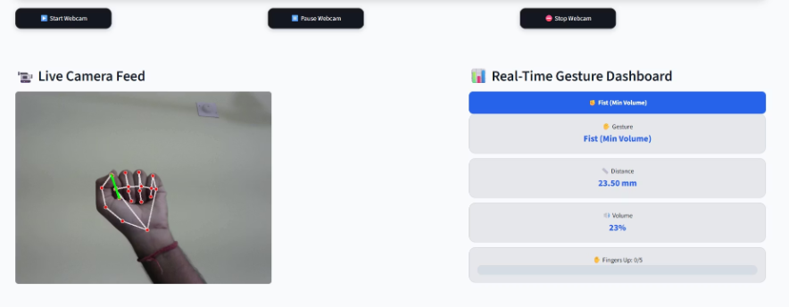
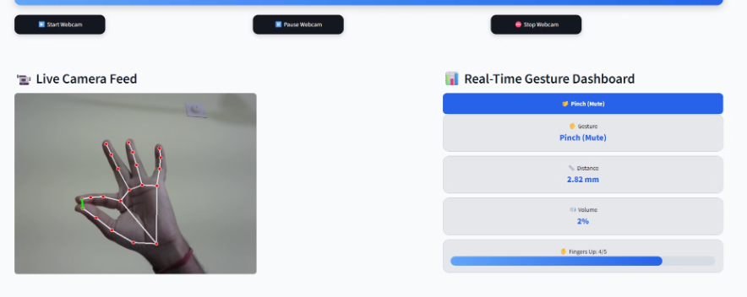
Final Output
These images show the actual hand tracking system's interpretation of each gesture.
Open Hand Detected
Closed Hand Detected
Pinch Gesture Detected
System recognizes an open palm, ready to increase volume.
System detects a closed fist for mute or volume reduction.
System identifies a pinch for precise volume adjustment.

Slide 14
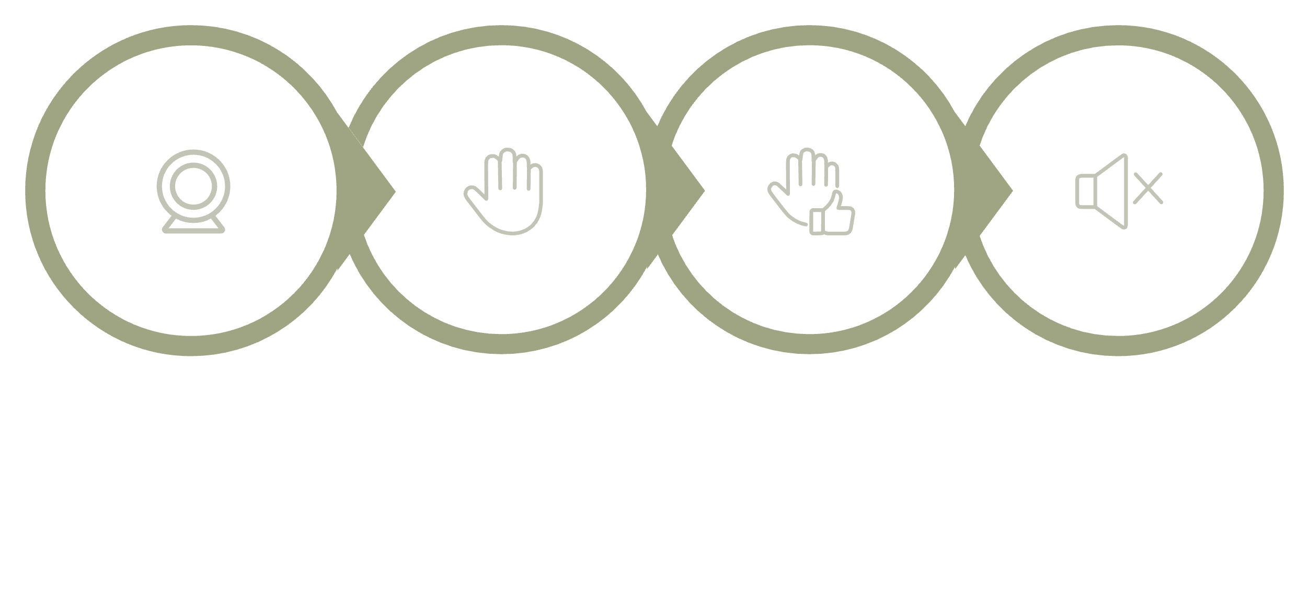




System Architecture & Workflow
Webcam Capture → MediaPipe Hand Detector → Gesture Analysis → Volume Control Logic → UI/Feedback Display
Webcam Capture
Hand Detection
Gesture Analysis
Volume Control

Slide 15
Challenges Faced
Implementation of the UI Interface
Lighting and Background Variations
Gesture Stability
Maintaining consistent gesture recognition while handling small finger movements and camera noise was difficult.
Designing and integrating a real-time, responsive Streamlit interface that updates live video, gesture data, and volume levels without lag was challenging.
Hand detection accuracy dropped under poor lighting or complex backgrounds, requiring careful tuning of detection parameters.
Volume Mapping Calibration
Performance Optimization
System Compatibility
Converting pixel distance into accurate volume percentages needed multiple trials and fine-tuning for smooth results.
Ensuring low latency between gesture detection and volume adjustment while running multiple libraries simultaneously.
Integrating PyCAW for volume control across different devices and ensuring proper permission access.

Slide 16






Future Advancements
Multi-Gesture Control
Cross-Platform Integration
Introduce additional gestures to control system functions such as play/pause, brightness, mute, or media navigation, expanding beyond volume control.
Extend compatibility to mobile devices and IoT systems for smart home and automation use, making gesture control ubiquitous.
AI-Based Gesture Prediction
Cloud & Voice Integration
Implement machine learning models to recognize complex or custom hand gestures for improved adaptability and personalization.
Combine gesture recognition with voice commands or cloud-based processing for enhanced and more natural interaction paradigms.
Improved User Interface
Design a more dynamic, customizable, and responsive dashboard with real-time analytics to provide richer feedback and user control.

Slide 17




Conclusion
This project successfully demonstrates the power of computer vision and AI in creating intuitive, touch-free interfaces. We've built a robust system that not only works but also paves the way for exciting future developments in human-computer interaction.
Project Success
Seamless Integration
Successfully demonstrated gesture-based volume control using advanced computer vision hand tracking technologies.
Achieved real-time, touch-free volume adjustment through the effective integration of OpenCV, MediaPipe, PyCAW, and Streamlit.
Enhanced User Experience
Future Potential
Delivers an intuitive and hygienic alternative to traditional control methods, requiring only a standard webcam for operation.
This project establishes a strong foundation for innovations in human-computer interaction, IoT integration, and AI-based automation.

